Slide 1
Statistical Modeling: The two cultures
By Gavin Whitesitt

Slide 2


Understanding Reality
y
nature
x
Goals:
Prediction. To be able to predict what the responses are going to be to future input variables
Information. To extract some information about how nature is associating the response variables to the input variables.
Slow-Mo Iodine Clock Reaction
Notes:
Nature forms the outputs y from the inputs x bymeans of a black box with complex and unknown interior.

Slide 3
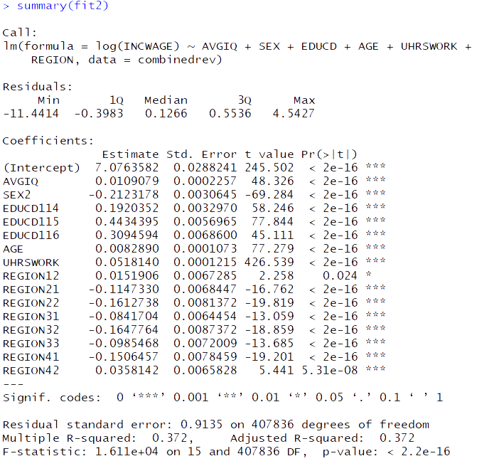
The Data Modeling Culture
98% of statisticians
Example:
linear regression
logistic regression
Cox model
y
x
Model Validation
Yes–no using goodness-of-fit tests and residual examination.

Slide 4
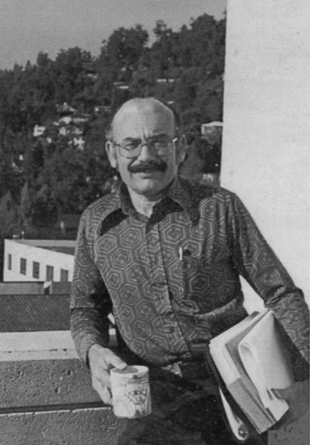
The algorithmic Culture
2% of statisticians
y
unknown
x
decision trees
neural nets
Model Validation
Measured by predictive accuracy.

Slide 5

focus in the statistical community on data models has:
Led to irrelevant theory and questionable scientific conclusions
Kept statisticians from using more suitable algorithmic models
Prevented statisticians from working on exciting new problems

Slide 6

The ozone project: 1970 Los Angeles
Objective: Predict alert level 12 hours earlier
Ozone levels primarily depend on meteorology of preceding days
450 meteorological variables for 7 year period
Train: first 5 years
Test: last 2 years
Tools used: large linear regression, variable selection.
Outcome: above acceptable threshold for false positive rate.
Failure

Slide 7
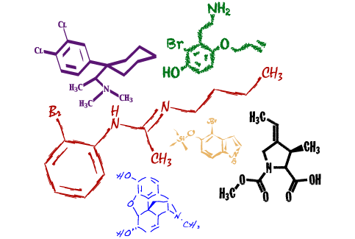
The Chlorine project
Objective: determine if presence of chlorine could be reliably predicted from its mass spectra
Data: known chemical structure and mass spectra of 30,000 compounds
Train: 25,000 compounds
Methods: Linear discriminant analysis, quadratic discriminant analysis, decision tree algorithm (using domain knowledge)
Outcome: LDA, QDA both unsuccessful. Decision tree resulted in 95% accuracy
Notes:
Mass spectra are produced by bombarding the compound with ions in the presence of a magnetic field. The molecules of the compound split and the lighter fragments are bent more by the magnetic field than the heavier. Then the fragments hit an absorbing strip, with the position of the fragment on the strip determined bythe molecular weight of the fragment. The intensityof the exposure at that position measures the frequencyof the fragment. The resultant mass spectra has numbers reflecting frequencies of fragments from molecular weight 1 up to the molecular weight of the original compound. The peaks correspond to frequent fragments and there are manyzeroes. The available data base consisted of the known chemical structure and mass spectra of 30,000 compounds. The mass spectrum predictor vector x is of variable dimensionality. Molecular weight in the data base varied from 30 to over 10,000. The variable to be predicted is y = 1: contains chlorine, y = 2: does not contain chlorine. The problem is to construct a function fx that is an accurate predictor of y where x is the mass spectrum of the compound. To measure predictive accuracythe data set was randomlydivided into a 25,000 member training set and a 5,000 member test set. Linear discriminant analysis was tried,

Slide 8

Lessons learned from consulting
Focus on finding good solution (that’s what consultants get paid for.)
Live with the data before you plunge into modeling
Search for a model that gives good solutions either algorithmic or data
Predictive accuracy on test sets is the criterion for how good the model is
Computers are an indispensable partner

Slide 9

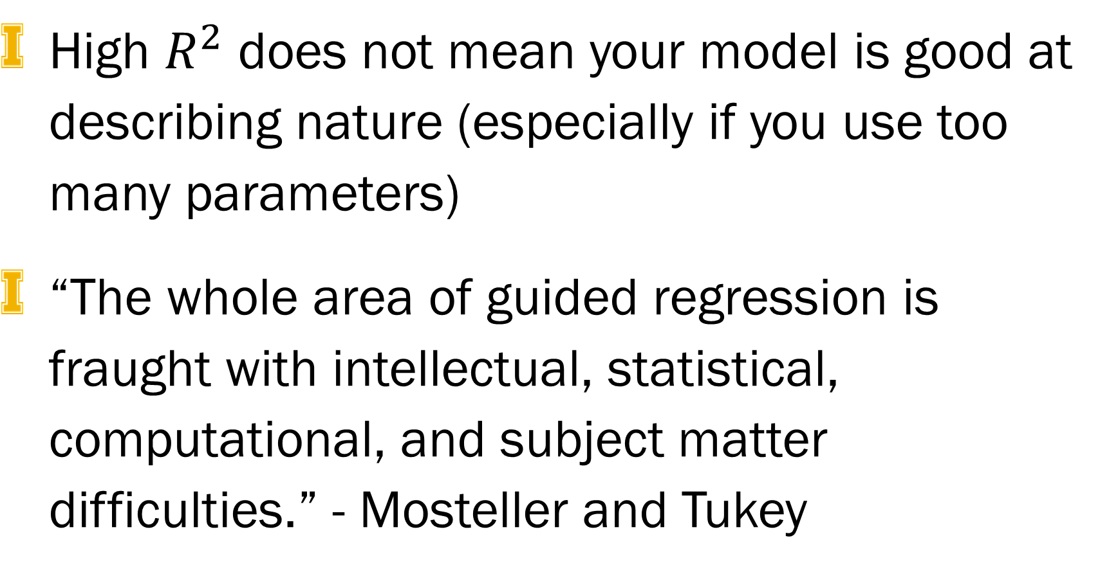
Issues IN academia
“Assume that the data are generated by the following model” – too many papers
Conclusions are about the model’s mechanism, and not about nature’s mechanism
If the model is a poor emulation of nature, the conclusions may be wrong
High $R^{2}$ does not mean your model is good at describing nature (especially if you use too many parameters)
“The whole area of guided regression is fraught with intellectual, statistical, computational, and subject matter difficulties.” - Mosteller and Tukey

Slide 10

Questions to ponder
Can the question asked be answered with the data available?
Is inference justified when entire population is used as sample?
Is it feasible that the data was generated by a linear model?

Slide 11

Rashomon
the multiplicity of good models
Based off of 1950 Japanese Film.
Each eyewitness to crime gives vastly different stories
there is often a multitude of different descriptions [equations fx] in a class of functions giving about the same minimum error rate
Aggregating over a large set of competing models can reduce the nonuniqueness while improving accuracy

Slide 12
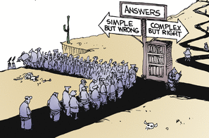
Occam
the conflict between simplicity and accuracy
Occam’s Razor is usually interpreted to mean that simpler is better.
Unfortunately, in prediction, accuracy and simplicity (interpretability) are often in conflict
“The goal is not interpretability, but accurate information.” - Brieman

Slide 13
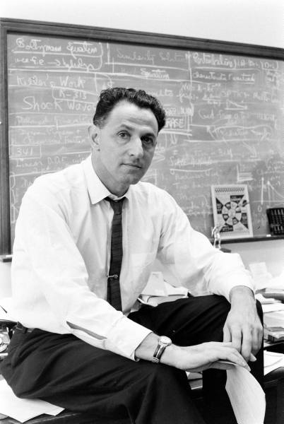
Bellman
Dimensionality curse or blessing?
William Cleveland, one of the fathers of residual analysis, admitted that residual analysis could not uncover lack of fit in more than four to five dimensions.
Data Modeling Culture: variable deletion advised. “high dimensionality is dangerous”
Algorithmic models often perform better when given more features. Most algorithms are “feature hungry”

Slide 14
